Slide 1
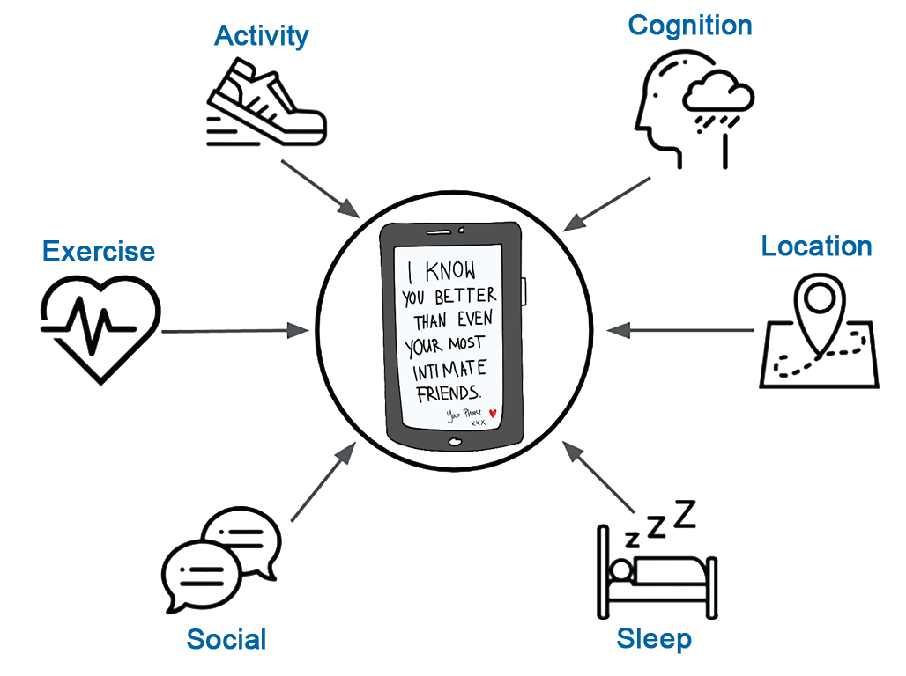

Personal Sensing for Harm Reduction and Precision Mental Healthcare in Substance Use Disorders
John J. Curtin, PhD
jjcurtin@wisc.edu
http://go.wisc.edu/arc

Slide 2
Program of Research
Develop explanatory models for the causes, consequence and prognosis associated with SUD and hazardous use
Develop suite of tools (and apps?) that use high dimensional prediction models for harm reduction in SUD
Lapse risk prediction
Early screening for psychiatric disorders (SUD, Depression)
Harm reduction surrounding hazardous substance use
Improve outcomes by using these same prediction models for
Precision mental health
Adaptive mobile health interventions

Slide 3
Personal Sensing
In situ (in the “real world”) measurement
Moment-by-moment quantification
Uses personal digital devices & biosensors
Data can be collected actively or passively
Provides a rich and temporally precise characterization of the individual-level human phenotype
Useful for both explanation and prediction

Slide 4
Mental Health Needs are High and Unmet
Need for mental health services is VERY high
Approximately 43.6 million (18.1%) Americans ages 18 and up experienced some form of mental illness in a given year
20.2 million adults (8.4%) had a Substance use disorder
14.8 million adults (6.7%) had Major depressive disorder
Most people with mental illness are untreated
9/10 with current SUD did NOT receive treatment in past year
2/3 with current Depression did NOT receive treatment in past year
Notes:
The need for mental health services is very high and the practical capacity of our current system to meet this need is woefully inadequate
STATS

Slide 5
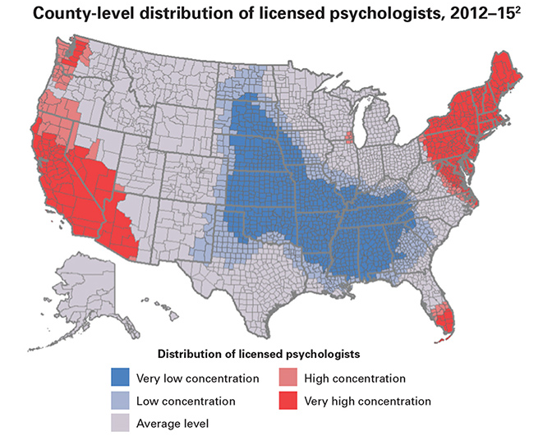
Geographic Access to Services is Limited
Notes:
There are many reasons that the capacity of our system isn’t sufficient to meet our needs
Access is one of the biggest: Consider the 43 million people diagnosed with mental illness in any year and compare that to the approximately 100 thousand licensed psychologists (or 500 K licensed therapists if you consider therapists from other disciplines like counseling and social work and related areas).
Also consider that these therapists are not distributed evenly across the country and their distribution does not reflect the distribution of need. These factors create a serious access problem
NOTES:
Source: https://www.apa.org/monitor/2016/03/datapoint
There are approximately 106,000 licensed psychologists in the United States,¹ but the distribution of those psychologists is uneven across the country. The number of licensed psychologists ranges from zero to 3,600 per county. Approximately 33 percent of counties have no records of licensed psychologists.
¹ American Psychological Association (2015). APA state licensing board list. [Unpublished special analysis]. Washington, DC: Author. The number of licensed psychologists was based on active doctoral-level licensed psychologist records from 2012–15 state licensing boards in 50 states and the District of Columbia.
² The map was based on the Getis-Ord statistic generated from county-level hot spot analysis based on the number of licensed psychologists per county. Different concentrations were statistically compared to the national average at the following probability levels: very low concentration (p < .01), low concentration (p < .05), high concentration (p < .05) and very high concentration (p < .01). Counties with no records of licensed psychologists were treated as zeroes. Due to large proportions of records with missing addresses in Hawaii, Oklahoma and Utah, state means of licensed psychologists per county for these three states were used in the analysis.

Slide 6
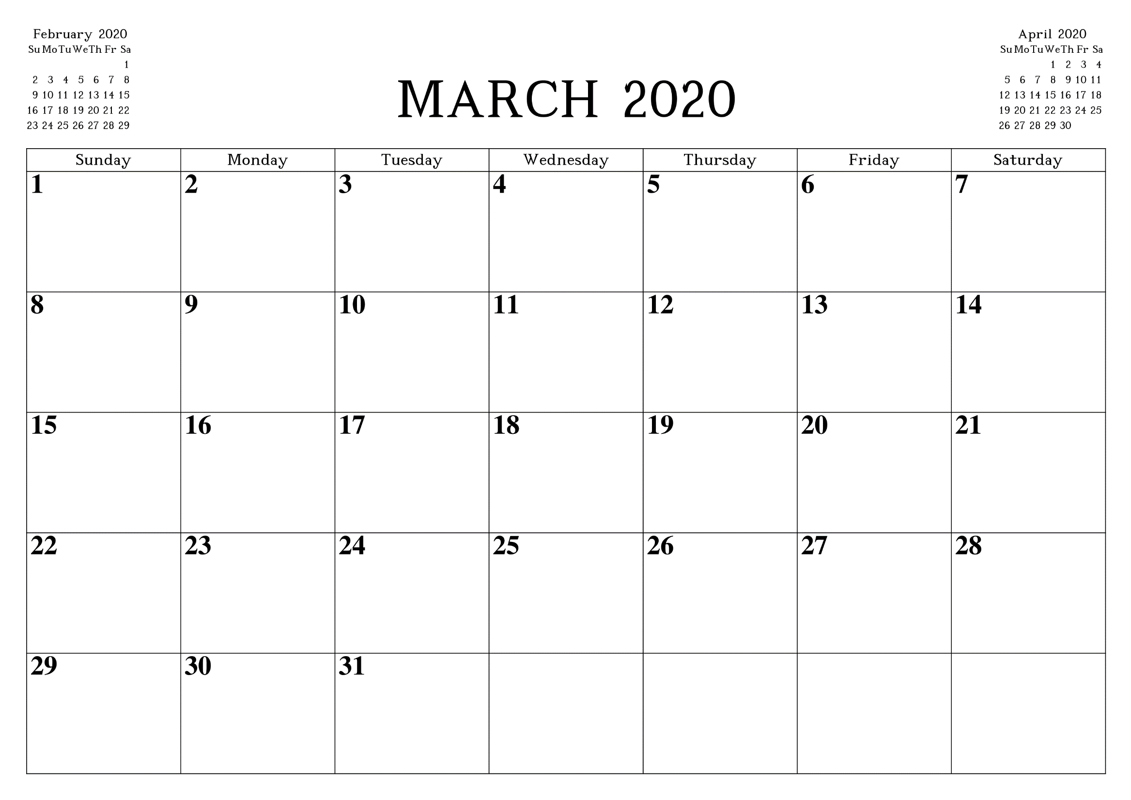
Temporal Access to Services is Limited
4pm: Therapy
4pm: Therapy
4pm: Therapy
4pm: Therapy

Slide 7
Other Factors Limit Access to Services
Limited geographic access
Limited temporal access
Cost
Stigma
Missed or delayed diagnosis
These problems are baked into the cake for traditional care model
Notes:
Then consider that even when therapists are available, the cost is often prohibitive, both because of limitations in insurance coverage for mental health services and for the many people from vulnerable groups that do not have insurance
Then consider the perceptions of stigma associated with seeking out help for mental illness and the perceived challenge of talking about the most intimate and personal details of your life with someone else.
Finally, consider that this same system is largely responsible for not only treatment but initial identification of mental illness. And that we often rely on the patient to first recognize themselves that they need help and seek services.
All of these issues combine to make the practical capacity of our mental health system too low to meet the need.

Slide 8
Mental Health System: Time for a Paradigm Shift
AI, machine learning, and mobile health applications are poised to produce “disruptive change” in how we assess/treat psychiatric disorders
Risk and prognosis prediction
Psychiatric classification
Precision mental health
Adaptive mobile health interventions
May address access, cost, stigma, early diagnosis, and effectiveness
May scale well
Supplement/augment services provided by therapists.
Notes:
However, I think we are poised for a paradigm shift in the treatments that we provide and the methods by which they are provided.
Specifically, I believe that AI, machine learning and related technologies are on the verge of producing a disruptive change in how we identify and treat psychiatric disorders.
There are a number of related efforts in this area but I want to highlight two efforts that are far enough along to generate some excitement.
Talk about each briefly
I want to propose that a key feature of these new approaches is that they SCALE very well to increase capacity to provide interventions. And with adequate SCALE, their effectiveness can be modest and they will still provide substantial aggregate benefit to reduce suffering from a population health perspective.
Can address:
cost [b/c they are inexpensive to implement and may reduce need of expensive time from therapists]
stigma (private, self directed)
Aid early diagnosis (efficient/massive diagnosis)
Improve effectiveness (could improve interventions by adapting to the person and moment in time)
I also want to emphasize that I am not talking about replacing human therapists. These are primarily new tools that clinicians can use to supplement or augment the mental health services that they are providing.

Slide 9
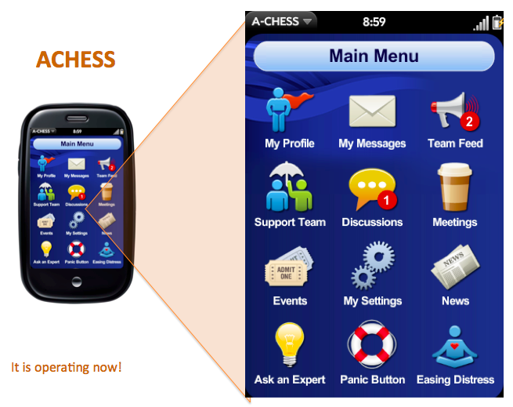
Addiction-Comprehensive Health Assessment Support System
Social Support
Discussion groups
Peer-to-peer
Panic button
Education and training
Distracting games
Guided relaxation & mindfulness
Tailored information and stories
Healthy event newsletter
Risk Identifier
Hi risk locator
Language analysis
Alerts
Appointment reminders
Medication reminders
Risk alerts
Clinician alerts
Assessments
EMA
Scheduled assessments
A-CHESS use
Virtual Counseling
Assertive outreach
Counselor contact
Video conferencing
Notes:
My lab is collaborating with colleagues in the Center for Health Enhancement Support Systems (or CHESS) to work on mHealth app development for continuing care.
CHESS is developing innovative health systems to optimize individuals' health behaviors, quality of life, and access to services. They have developed apps to support patients with cancer, asthma and other chronic diseases but we are helping them specifically on developing a continuing care system for addiction, that they refer to as A-CHESS.
[SHOW VIDEO]

Slide 10
RCT Evidence of A-CHESS Efficacy
N=349; recruited from residential care for AUD
Randomly assigned to A-CHESS vs. TAU for 8 months
Follow-ups at 4, 8, and 12 months
A-CHESS reduced risky drinking days > 50%
A-CHESS increased point prevalence abstinence (52% vs. 40%)

Slide 11
Patients Don‘t Self-monitor Well
SUD is a chronic relapsing disorder
Life-long risk monitoring is difficult
Patients often didn’t engage with A-CHESS prior to lapse/relapse
GOAL:
Develop a sensitive lapse monitoring system and integrate it within A-CHESS
System can provide this information directly to patient and/or clinician

Slide 12

Study Design
153 patients with AUD
Early in recovery (1-8 weeks)
Collect passive and active signals to predict lapse
Follow for up to 3 months (90 daily observations of lapse per person; ~13,500 cases)
Predict future probability of lapse by day (hour, week?)

Slide 13
Available Data Signals
Active signals
Static trait self-report measures (1X at study start)
Temporally coarse self-report (3X - monthly)
Temporally precise self-report
4X daily ecological momentary assessments
1X daily (morning) audio check-ins (text and audio signal)
Passive signals
GPS location
Places (location and time)
Tracks (location and movement type)
Voice and SMS (text messages) logs
Meta data
SMS text content
Sleep sensor (Wake/sleep times; sleep efficiency; wakings; restlessness)

Slide 14
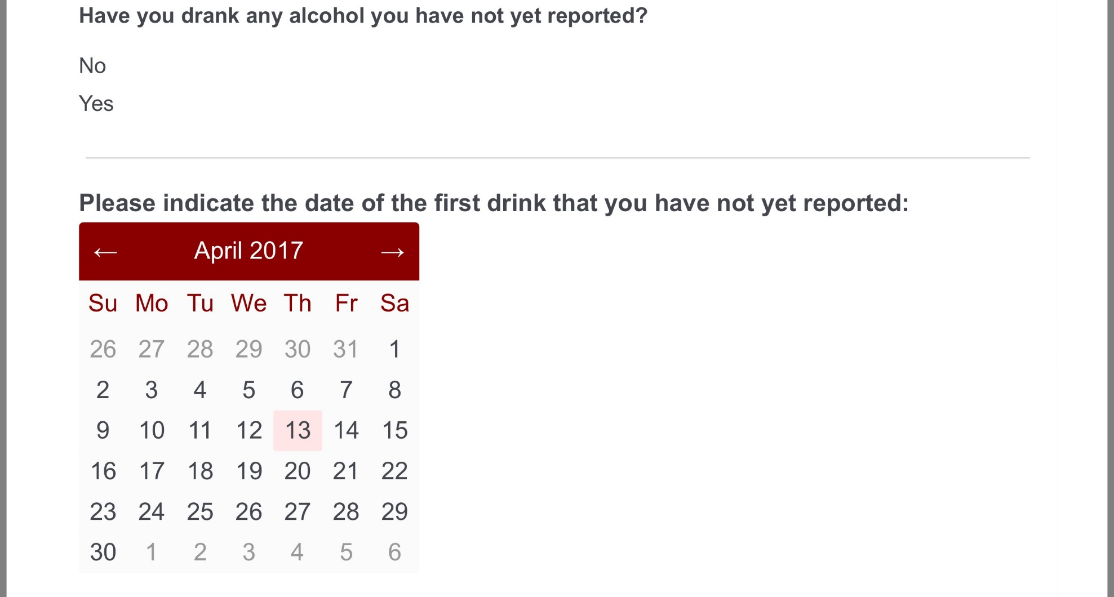

4x Daily Ecological Momentary Assessments
Current
Craving
Risky situations
Stressful events
Pleasant events
Affect
Future
Risk situations
Stressful events
Efficacy

Slide 15
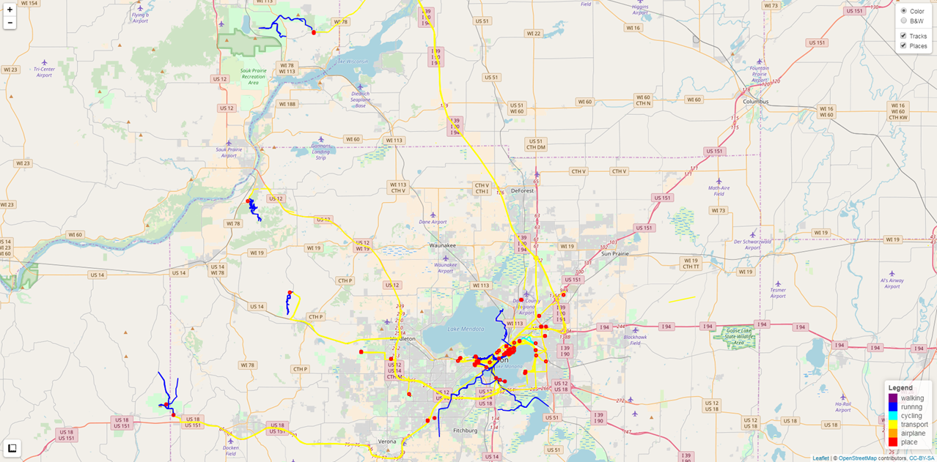
My GPS History
Notes:
Day trips outside of Madison
Weekend trail running in WI parks
Long runs outside of Madison

Slide 16
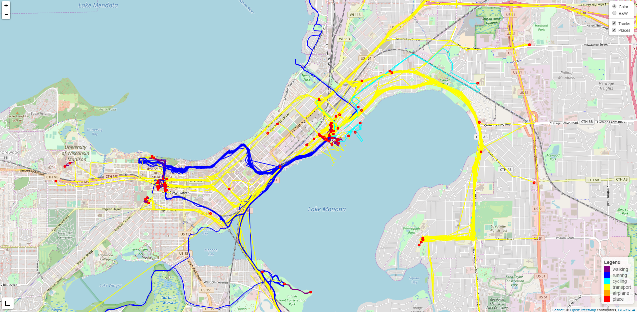
My GPS History
Notes:
Tracks & Places in Madison
Daily commute to Jake’s and Hana’s schools
Daily run commute to work
Coffee shops I like
Snow biking with Jake
Hiking with family

Slide 17
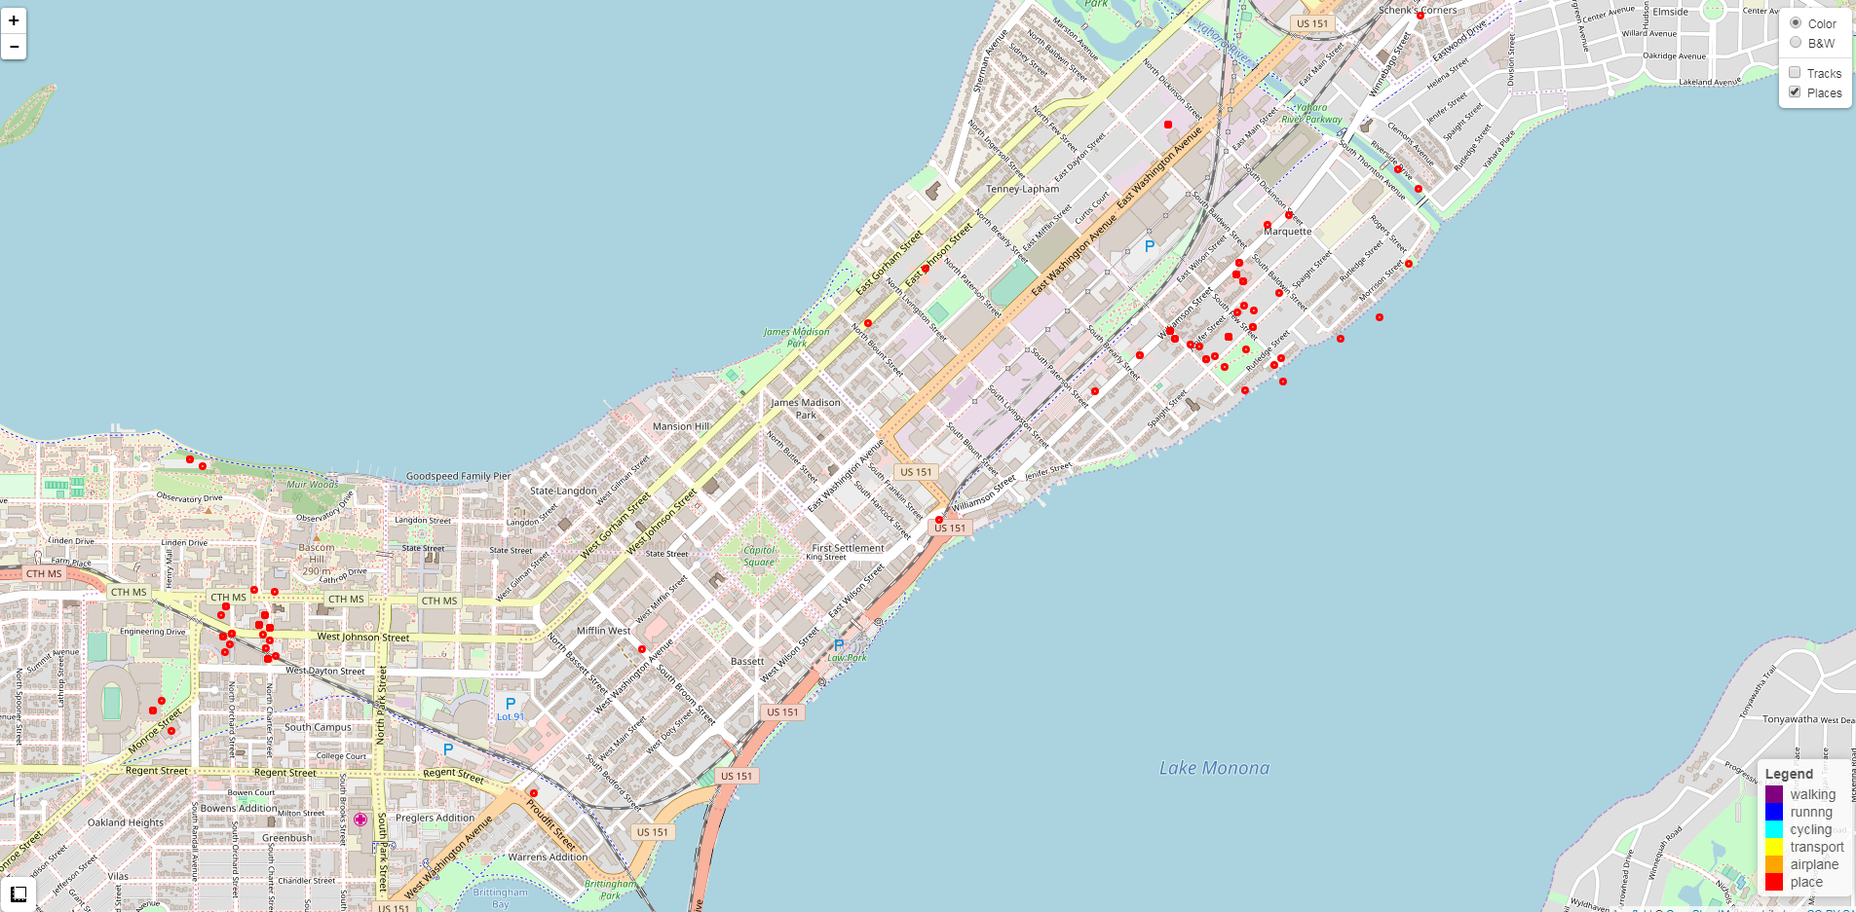
My GPS History

Slide 18
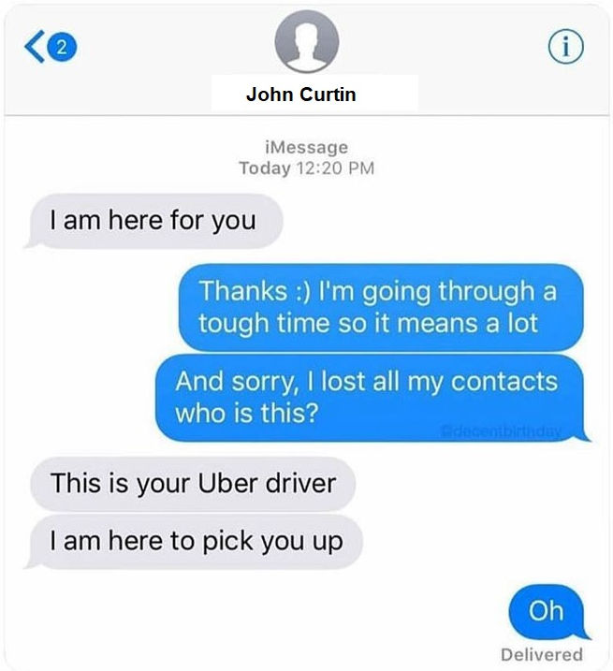
Image My Cellular Communications.........

Slide 19
Context is Critical
Within person change (all signals)
Contextualized GPS
Contextualized Voice and SMS Communication

Slide 20
Contextualized GPS
Type of Place:
 Home  Work
 Home of Friend  Home of Family Member
 Liquor Store  Coffee Shop/Cafe
 Restaurant  Park
 Bar  Gym/Fitness center
 AA/Recovery Meeting
Alcohol context:
 I’ve drank alcohol here before
 Alcohol is available here
This place is generally:
Pleasant Unpleasant Mixed Neutral
This place is :
High risk Moderate Risk Low risk No risk

Slide 21

Contextualized GPS
Type of Place:
 Home  Work
 Home of Friend  Home of Family Member
 Liquor Store  Coffee Shop/Cafe
 Restaurant  Park
 Bar  Gym/Fitness center
 AA/Recovery Meeting
Alcohol context:
 I’ve drank alcohol here before
 Alcohol is available here
This place is generally:
Pleasant Unpleasant Mixed Neutral
This place is :
High risk Moderate Risk Low risk No risk

Slide 22
Contextualized Voice and SMS
Have you drank alcohol with this person?
Never/Almost Never Occasionally Almost Always/Always
What is their drinking status?
Drinker Non-Drinker Don’t Know
Would you expect them to drink in your presence?
Yes Uncertain No
Are they currently in recovery from alcohol/other substances?
Yes No Don’t Know
Do they know about your recovery goals and if so are they supportive?
Don’t Know or Supportive Unsupportive Mixed Neutral
Are your experiences with this person typically…
Pleasant Unpleasant Mixed or Neutral?
Can link contacts context to location of homes of friends/family

Slide 23
Available Preliminary Data
N=115 of 150 (N=153 available)
Lapse by DAY
9744 observations
790 lapses; 8% of days
1466 “features” (predictors) from subset of data signals
1X Static/Trait
3X Coarse Self-Report
EMA
Some GPS
Some cellular (Voice, SMS) meta data
General (day, date, lapse history)

Slide 24
Many More Predictors Available
And we have really just started to code predictors........
Still more GPS place; GPS tracks; GPS with passive context
Still more meta data from Voice and SMS
Natural language processing on SMS text content
Natural language processing on daily check ins
Acoustic characteristics of daily check ins
Sleep signals
and interactions; non-linear effects of predictors

Slide 25
Machine Learning Classifier and Training
Generalized Linear Model Elastic Net (regularized logistic regression)
Provide probability estimates
Does predictor selection
Predictors are interpretable (not black box model)
3x repeated 10-Fold Cross Validation
Provides robust evaluation of how models will work on new patients that the model has not seen (not trained on)

Slide 26
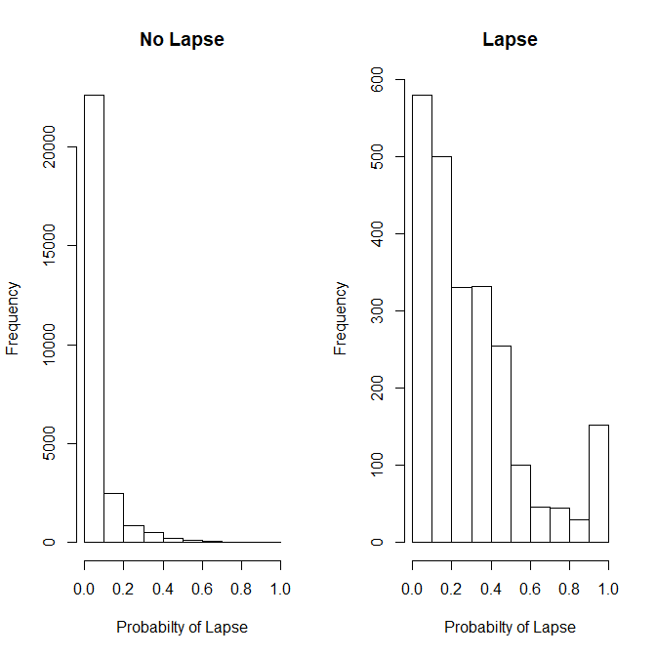
Model Probabilities for No Lapse and Lapse Observations
Model predicts probability of lapse in next day for “new” observations
Can separate predictions for TRUE lapse and no lapse days
Want low probability for true no lapse and high probability for true lapse
Can pick cut-score for classification
Notes:
So let me talk a moment to make the predictions that this machine learning model provides concrete
On the right, you are looking at predictions that the model makes for whether or not a specific patient will lapse on a specific day.
These are predictions for patients and days that the model hasn’t been trained on.
The model predicts the probability that a lapse will occur.
I’ve separated these predictions out by whether a lapse did or did not happen in reality for each predicted case.
Ideally, you want all the predicted probabilities to be very low (to the left) on days where there was not a lapse and very high (to the right) on days where there was a lapse.
You can see we are doing well on No Lapse days.
Also doing OK on lapse days but there are clearly some we are going to miss depending on what cut score we use to move from continuous probabilities to discrete dichotomous predictions of lapse or no lapse for each day within each patient.

Slide 27
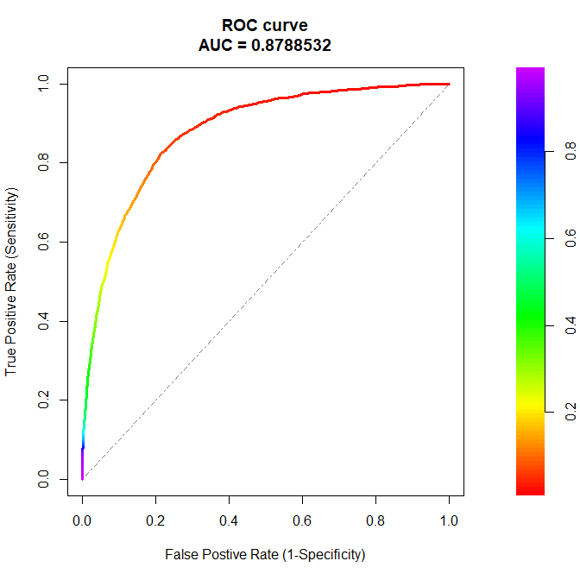
Preliminary Model Performance for NEXT DAY
Using ALL AVAILABE features/predictors
AUC = 0.88 (dotted line - Random model) (perfect model reaches top left)
Accuracy = 96%
Clinically Useful Cut-Point
True Positive Rate = .90
False Positive Rate = .30
X

Slide 28
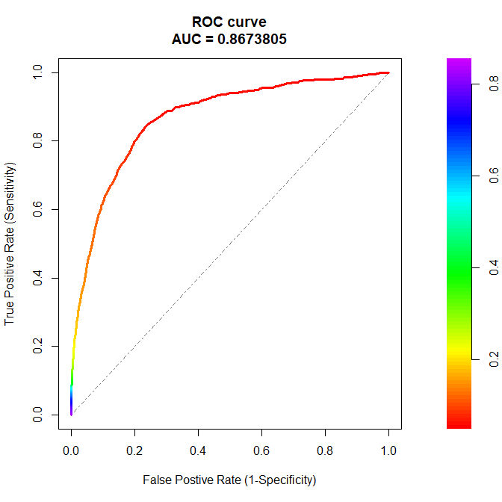
Excluding EMA Predictors: EASIER IMPLEMENTATION
AUC = 0.87
Accuracy = 96%
Clinically Useful Cut-Point
True Positive Rate = .89
False Positive Rate = .30
X
Notes:
This model performs essentially the same even if we remove all predictors based on EMA. This means we can implement this model without the most burdensome data source

Slide 29
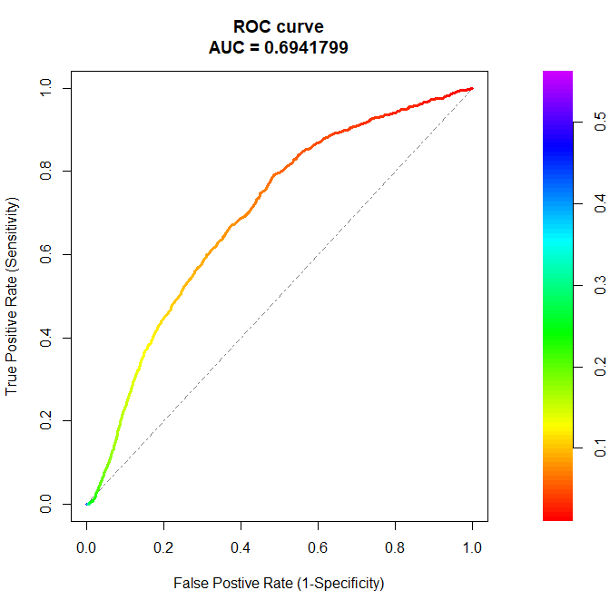
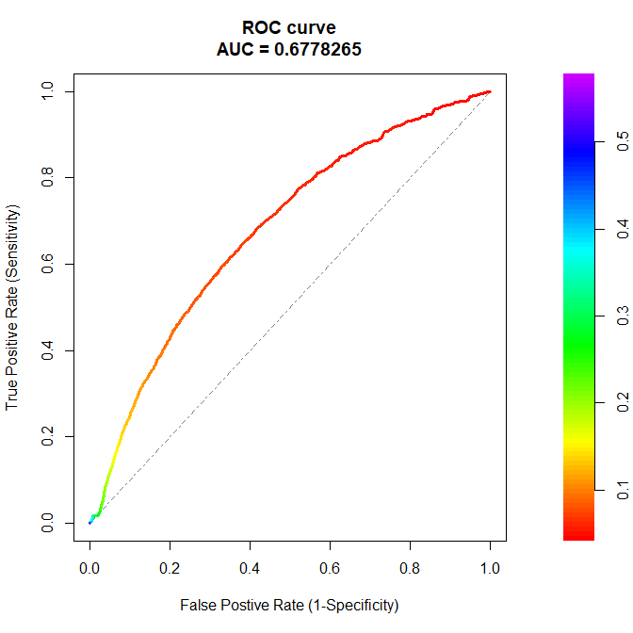
Cellular Only & GPS Only Models: Early Stages
Cellular Only
GPS Only
Notes:
These models are already performance well above change for each of our two most passive data sources: Cellular and GPS. Most importantly, we have only scratched the surface so far with respect to extracting features/predictors for these two data sources. For example, we are not yet doing any natural language processing on the SMS content. We are also not using any track information from GPS (only places). These signals will become much more powerful once we more fully exploit them. Given this early performance I fully expect to be able to build models that perform well and use only these passive data sources

Slide 30

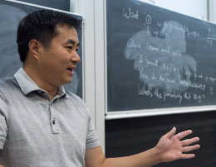
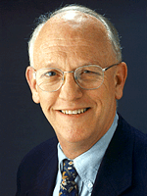


Lapse in patients with Opioid Use Disorder
Recruiting patients in recovery from Opioid Use Disorder
More variation in stage of recover (1 – 12 months at start)
12 months of monitoring
Close to real implementation methods
National sample (size; diversity: demographics, location)

Slide 31

Precision Mental Health vs. Traditional Tx Approach
Treatment A
Treatment B
75 % Effective
25 % Effective

Slide 32



Precision Mental Health
Capitalize on individual differences that could affect treatment response
Use machine learning to capture complexity and enable generalizability
Apply first to smoking cessation as proof of concept
Notes:
One way to improve treatment outcomes would be to capitalize on individual differences that might affect treatment response FOR THAT INDIVIDUAL and use them to assign the person to the treatment predicted to work best for them. This idea is commonly referred to as precision medicine.
In the past, PM research has been conducted with only one or a small handful of predictors simultaneously, so we have been unable to capture the complexity of a clinical phenomenon like treatment response.
To progress with PM, we must use analytic techniques like machine learning that can handle high-dimensional arrays of predictors and thereby capture that complexity. ML models offer another benefit in that they are evaluated by how they perform in new data not used to generate the model. Thus, they prioritize generalizability, which is critical if we hope to apply the models we build to new patients in the clinic.
In the current project, I applied this combination of machine learning and precision medicine to smoking cessation. Smoking remains a critical public health burden. Unfortunately, even our best available treatments only work for about a third of people who try them.

Slide 33
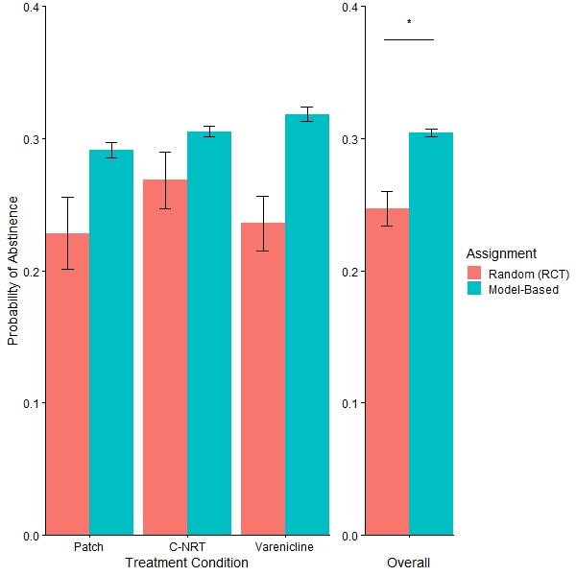

Precision Mental Health
Improvements within treatment conditions
Treatment matching significantly improves overall predicted abstinence
Notes:
I’m going to walk you through those results now. Throughout the figure, abstinence rates from the original trial are in pink, and model-based predicted abstinence is in blue. On the y-axis is probability of abstinence.
First, you can see that treatment matching improved predicted abstinence rates within each of the three conditions.
When we look at overall rates collapsed across treatments, the predicted abstinence rate from our model-based assignment was 6% higher than the abstinence rate from the original trial. We were quite excited about this, and here’s why.

Slide 34

Social media signals for passive, massive screening
Diagnosis of AUD
Prediction of binge episodes
Started with high risk (college) sample (N ~ 900)
Expand to community sample (w/ grant funding)

Slide 35

Adaptive A-CHESS
(Daily?) recommendation for optimal tools/services for that person and that “moment” in time
Similar features to lapse risk prediction projects
Contextualized multi-arm bandit

